Slide 1
Applications of Graph Theory in Computer Science
Name : Rupak Sarkar Roll No.: 01 Stream : MCA Semester : Semester 1st Subject : Discrete Mathematics Subject Code : MCAN-104

Slide 2
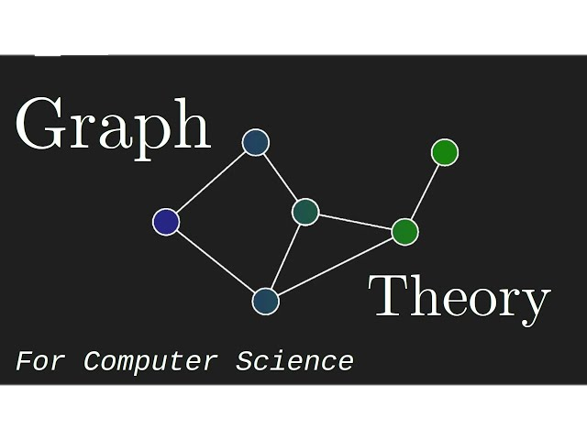
What is Graph Theory? Graph theory is a branch of mathematics that studies structures used to represent relationships between objects. These structures consist of vertices (nodes) and edges (connections).
Significance in Computer Science
Graph theory is essential in computer science as it offers efficient frameworks for modeling and addressing problems related to networks, relationships, and data structures. It forms the backbone of numerous computational applications, including computer networking, database management, artificial intelligence, and machine learning.

Slide 3

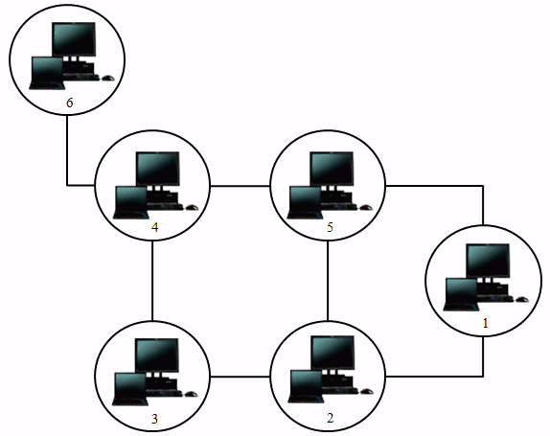
Applications of Graph Theory in Networking:
Shortest Path Algorithms: Graphs are used to model network topologies, and algorithms like Dijkstra’s or Bellman-Ford help in determining the shortest path between two nodes in a network.
Distance Vector and Link State Protocols: These protocols (like RIP and OSPF) rely on graph-theoretical concepts to determine the best paths for data transmission in dynamic networks.
Structure Design: Graph theory is used to design the structure of networks. For instance, a network can be modeled as a graph where the nodes represent devices (routers, switches, etc.) and the edges represent communication links.
Network Connectivity Analysis: Graph theory can be used to analyze the
connectivity of networks, ensuring that nodes are adequately connected
through paths that don’t fail easily.

Slide 4
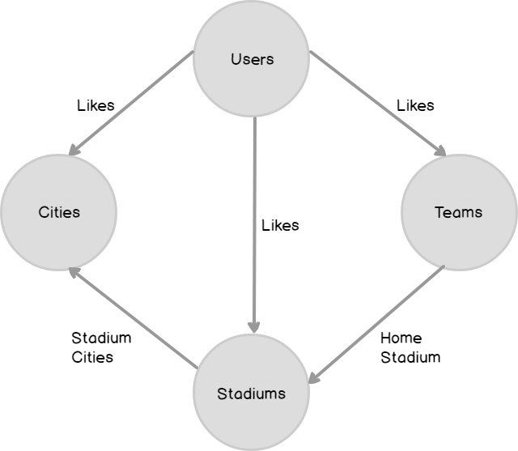
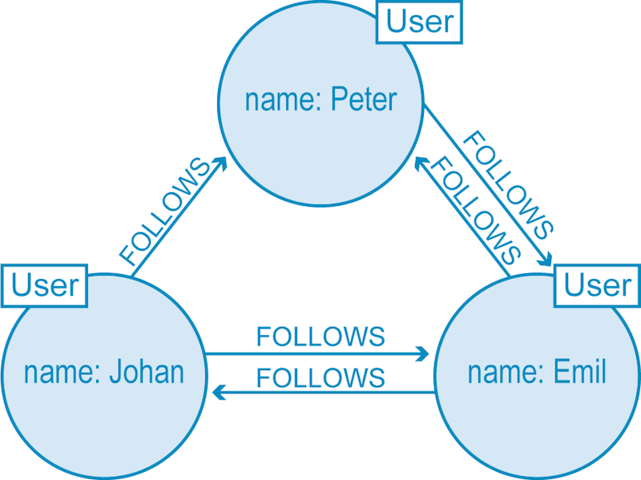
Applications of Graph Theory in Database and Query Optimization:
Query Plan Graphs: In query optimization, databases take the help of graph representations where nodes represent joints and edges represent data flow between operations.
Join Optimization: Queries involving multiple tables often require joints, which can be optimized using graph theory.
Graph Databases: Graph theory is used to build specialized graph databases.
Indexing and Querying: In relational databases, graph theory can improve indexing strategies, allowing for faster retrieval of related data by indexing relationships between tables.

Slide 5
Applications of Graph Theory in Software Engineering:
Modeling Software Components: Graph theory helps in representing the components of a software system as nodes and the interactions between them as edges.
Coupling and Cohesion Analysis: Graph theory helps in evaluating coupling and cohesion.
Dependency Graphs: In large software projects, managing dependencies between libraries, modules, or packages is critical.
Data Flow Analysis: Data flow graphs model the flow of data through a program, helping to identify variables that are used, defined, or propagated through different parts of the code.
Refactoring with Graphs: Graph theory helps identify areas of code that need refactoring by analyzing the structure of the software.

Slide 6
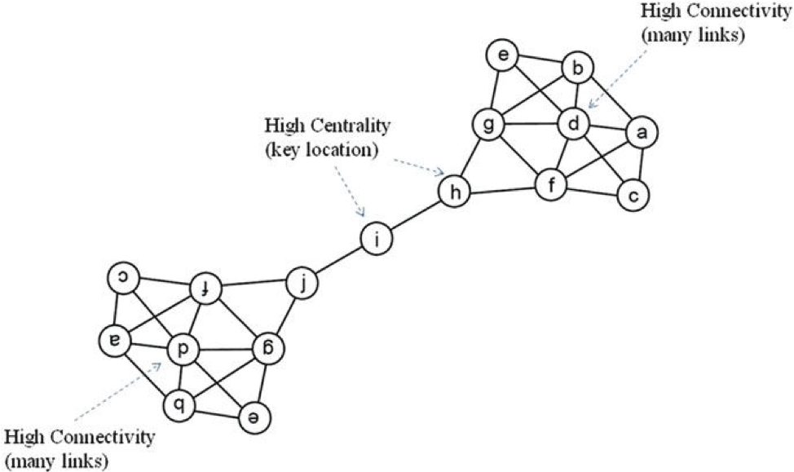
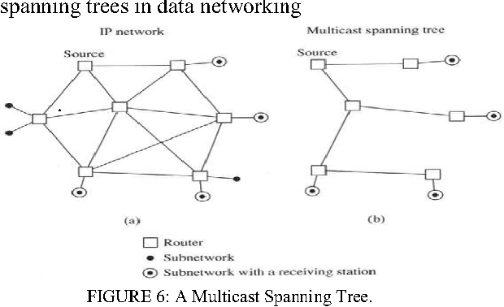
Applications of Graph Theory in Cyber Security:
Attack Graphs: In cybersecurity, an attack graph is a representation of the possible paths an attacker might take to exploit vulnerabilities in a system.
Anomaly Detection in Network Traffic: Graph-based techniques are used to detect unusual patterns in network traffic.
Malware Behavior Analysis: Graph theory is used to model the behavior of malware by representing different activities.
Vulnerability Dependency Graphs: Systems are often made up of multiple interconnected components, and vulnerabilities in one component can affect others.

Slide 7
Thank You!

